Slide 1
Detecting Engagement in Egocentric Video
Yu-Chuan Su and Kristen Grauman
The University of Texas at Austin

Slide 2
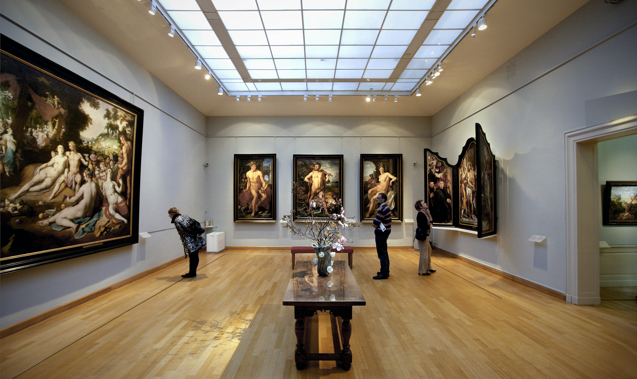


Imagine this is where you are …
People do not always engage with what they see
How likely would you engage with what you see?

Slide 3

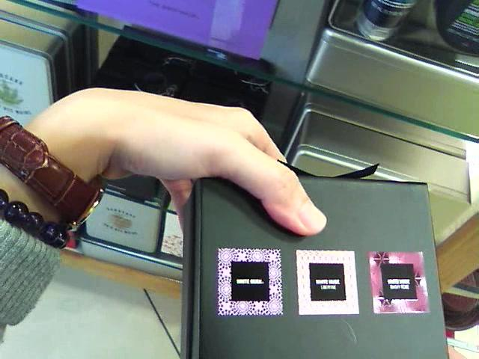
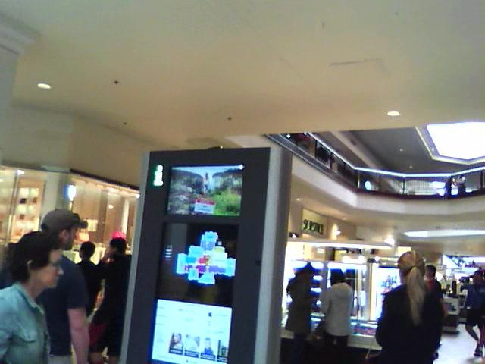

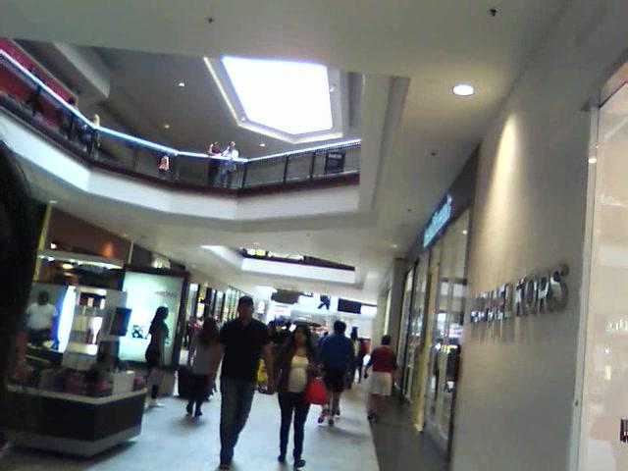
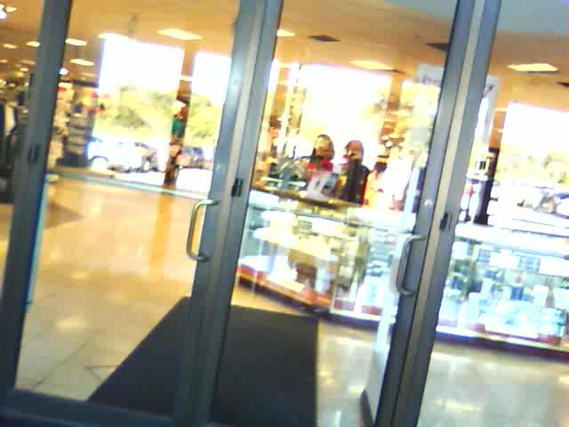
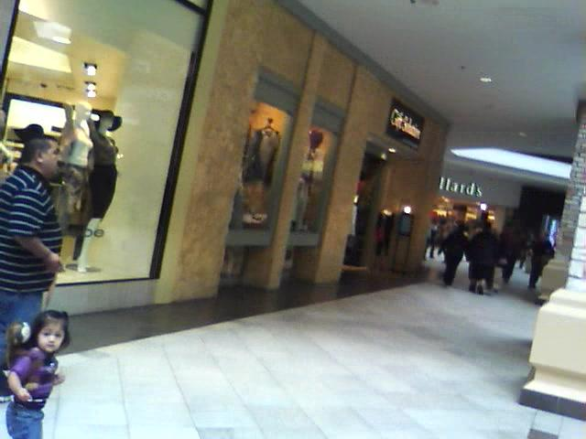


Goal: Detect egocentric engagement
Engagement
Level
Detection
Detection
Time
!

Slide 4
Goal: Detect egocentric engagement
Definition: High engagement interval
If the recorder
is attracted by some object(s)
purposefully gathers information of the object(s)
Engagement
Level
Detection
Detection
Time

Slide 5
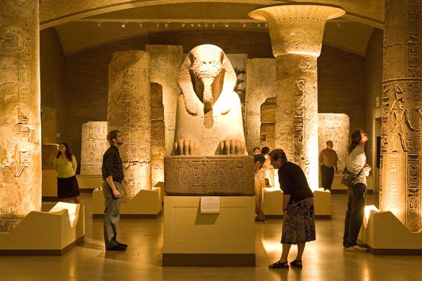
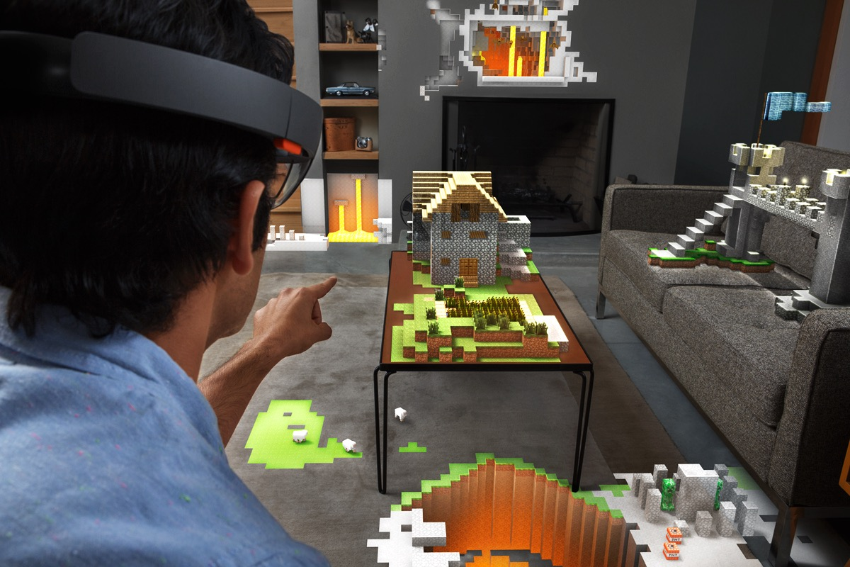
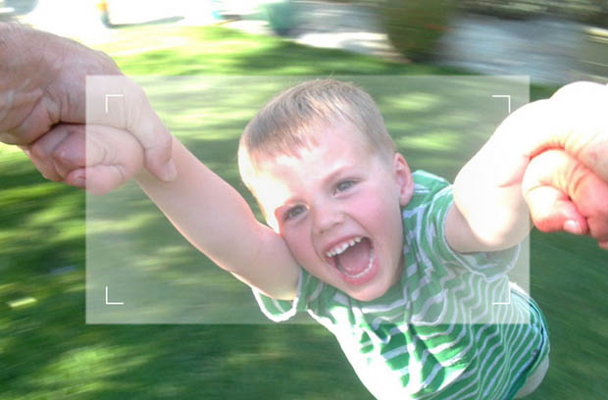
Applications of ego-engagement
Behavior analysis
VR display
Intelligent camera control

Slide 6
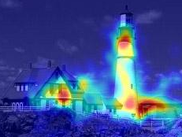
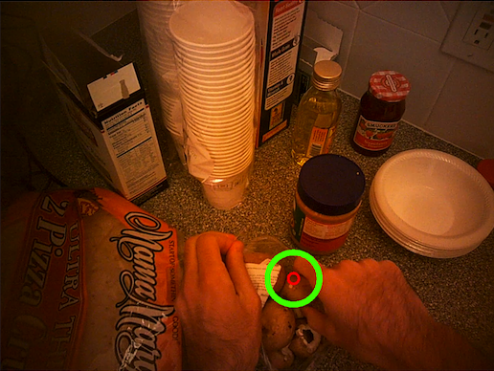
Saliency/Gaze vs. Engagement
Saliency – predict where third-party
viewer’s gaze is
[Harel et al. 2007, Itti & Baldi 2009, Rudoy et al. 2013, …]
Egocentric gaze – predict where the
camera wearer is looking
[Li et al. 2013, Yamada et al. 2012]
Saliency/gaze does not capture when a person is engaged with what he sees

Slide 7


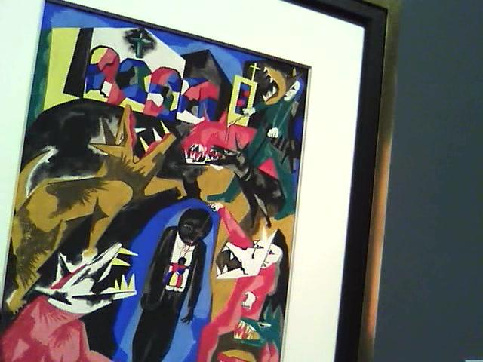





UT Egocentric Engagement dataset
Focus on “browsing scenarios”
27 videos recorded by 9 subjects (recorders)
14 hours total length
Frame-level engagement label by 10 annotators

Slide 8
Annotation analysis
To verify engagement is predictable, we evaluate
How consistent are the annotations by annotators?
Can annotators predict recorder engagement?
Engagement is predictable from egocentric video

Slide 9
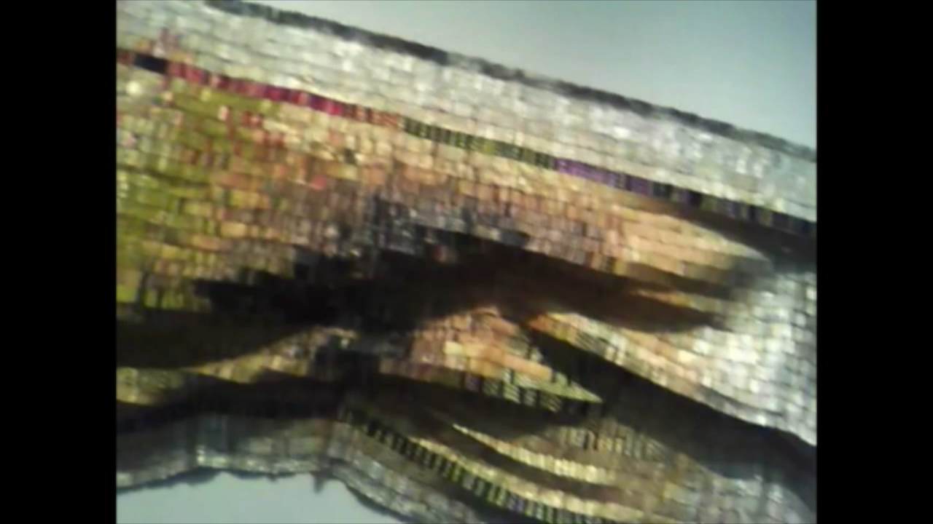
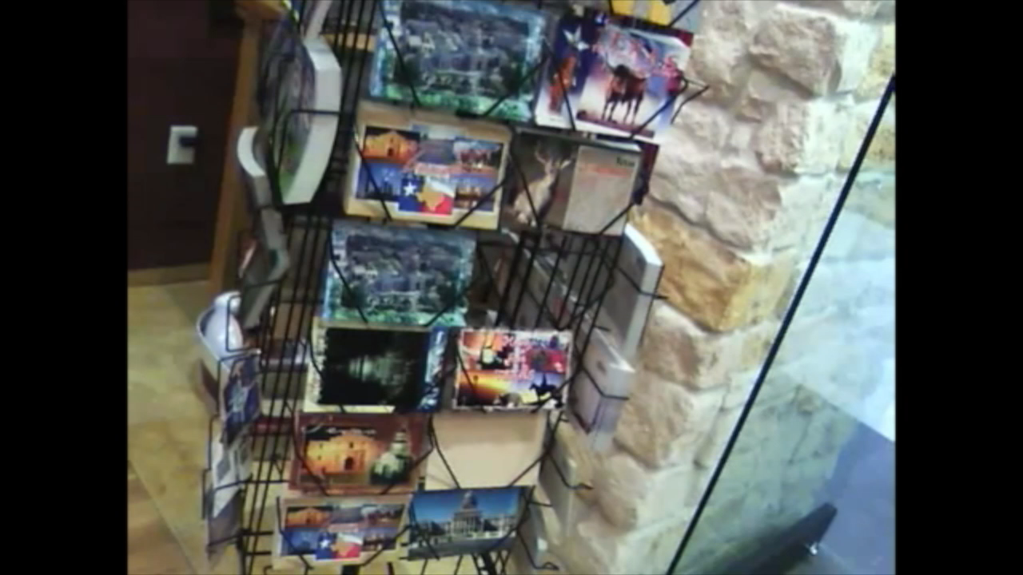

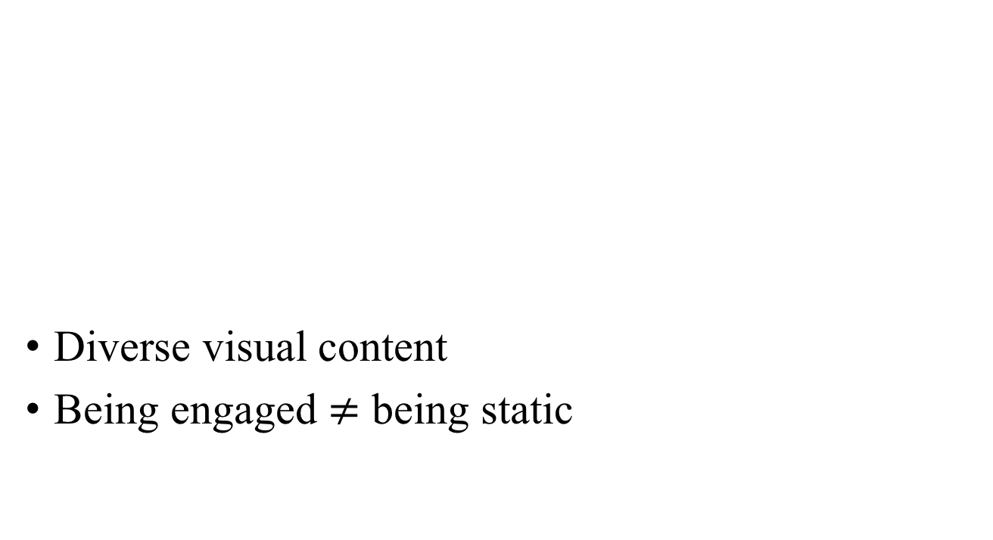
Challenges for detecting engagement
Diverse visual content
Being engaged $≠$ being static

Slide 10
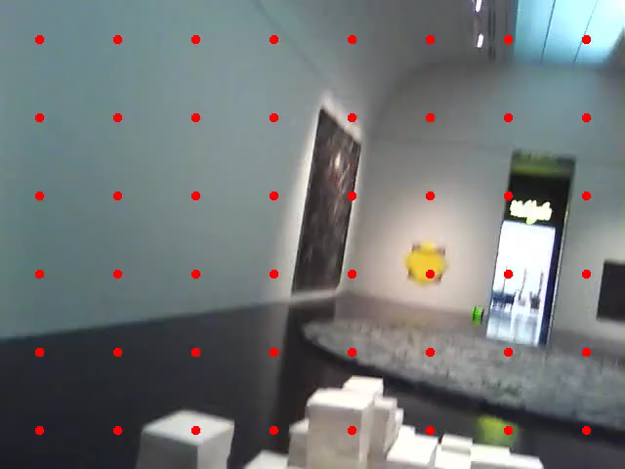
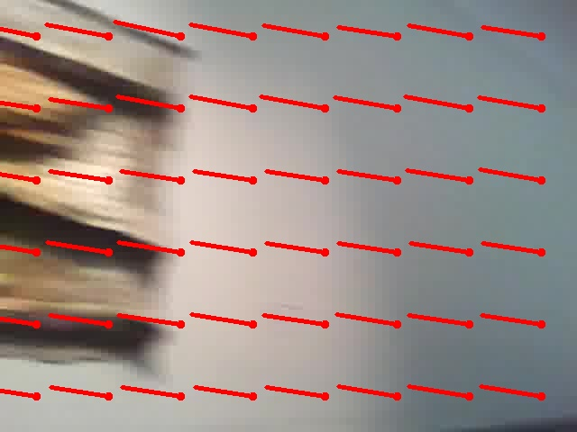
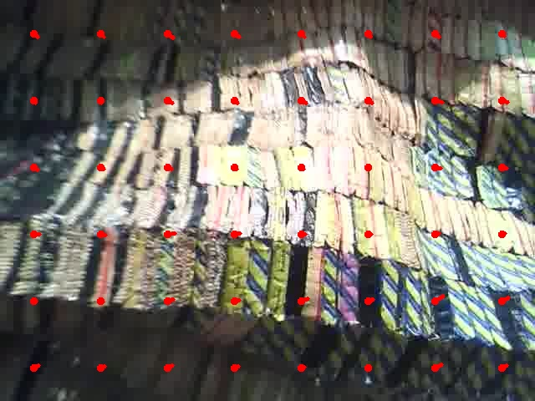
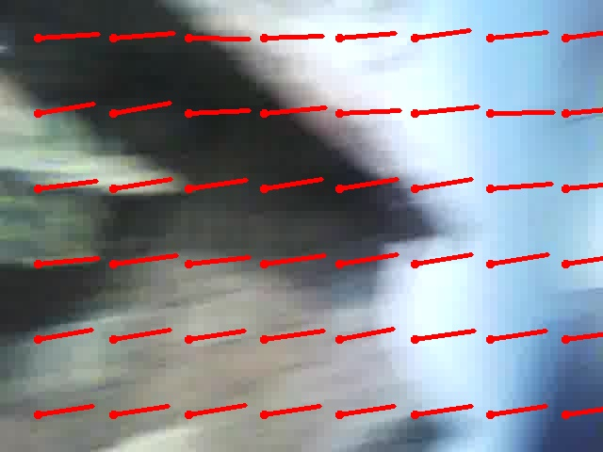
Solution: Predict from motion
Our approach
Estimate frame-wise engagement
Generate interval hypotheses
Estimate engagement per interval

Slide 11



1. Estimate frame-wise engagement
Frame-level engagement estimator
Engagement Level
t

Slide 12
2. Generate interval hypotheses
Level set method
Interval hypotheses
Engagement Level
Interval
t

Slide 13
3. Estimate engagement per interval
Temporal pyramid
over motion
Interval-level
engagement estimator
Final
Prediction

Slide 14
Experiment results
Our method performs the best in all settings & datasets

Slide 15
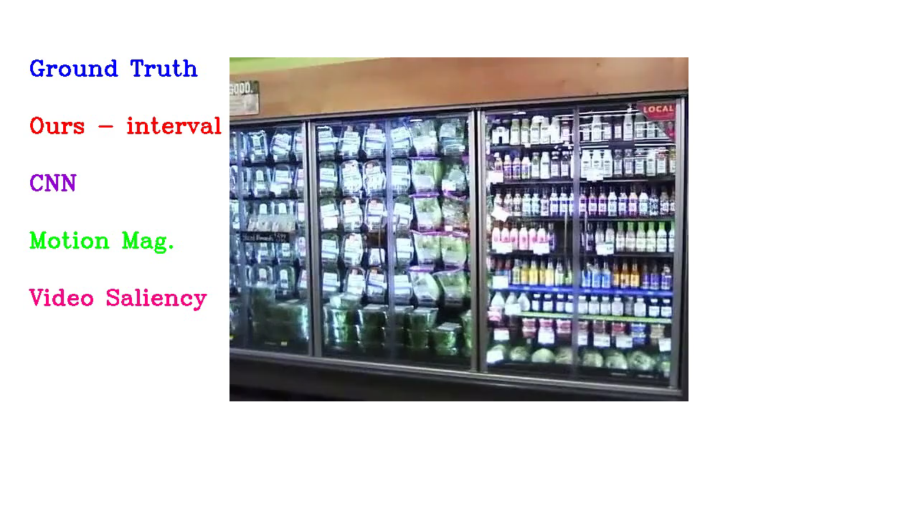
Ego-engagement prediction (1/2)

Slide 16
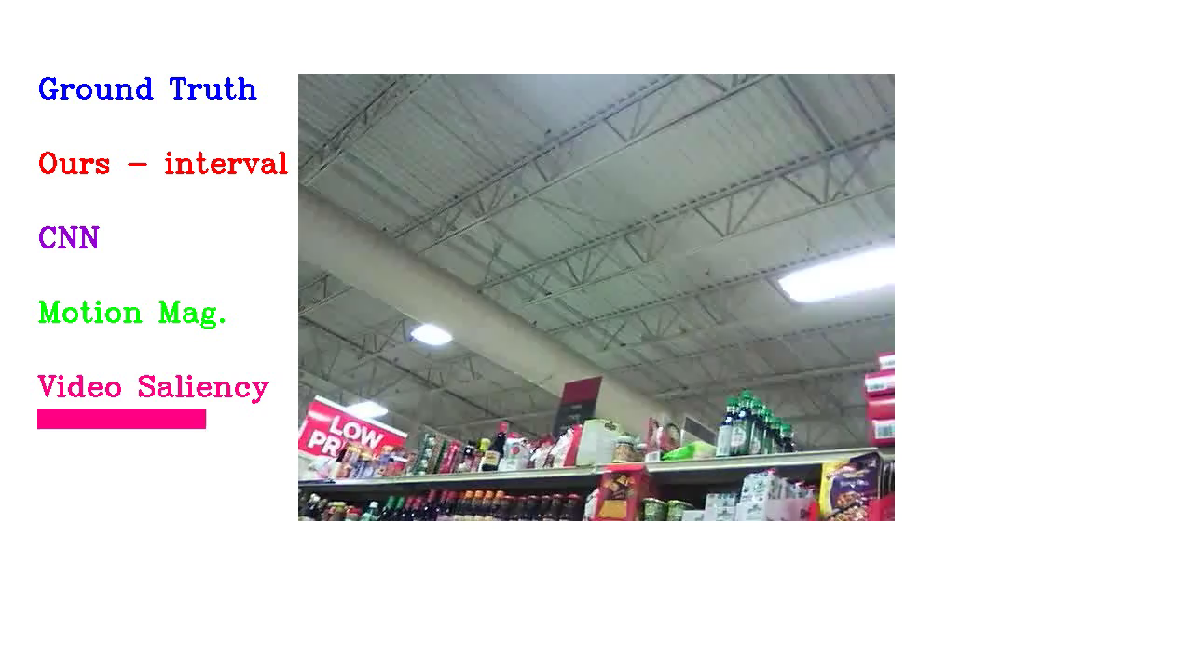
Ego-engagement prediction (2/2)

Slide 17
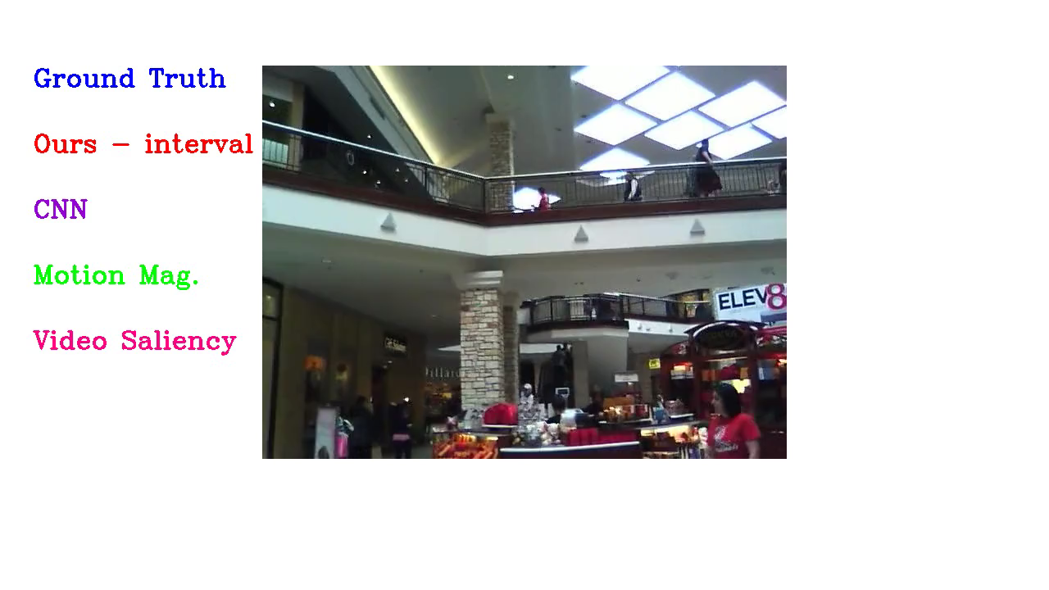
Failure case

Slide 18

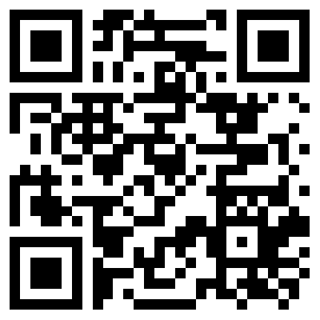
Conclusion
Engagement is predictable from egocentric video
UT EE – a new dataset for egocentric engagement
http://vision.cs.utexas.edu/projects/ego-engagement

Slide 19
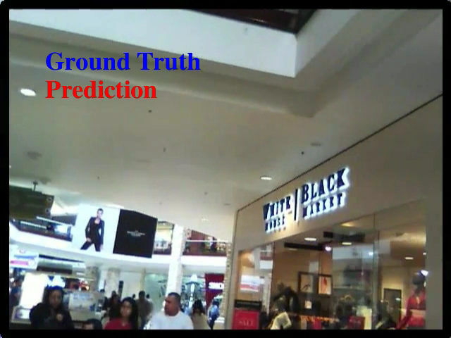
Failure case (2/2)

